Slide 1
PID Controller Tunning
Dr. Enrique Aguayo-Lara

Slide 2

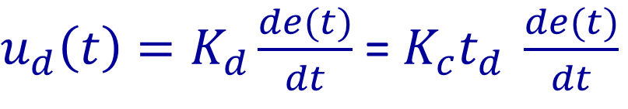
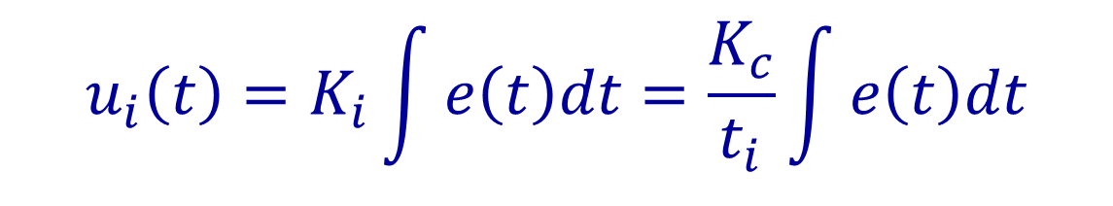
PID
Proportional (proportional to the error)
Integral (proportional to the integral of the error)
Derivative (proportional to the derivative of the error)
$$u_{p}\left(t\right)=K_{c}e(t)$$
$$u_{i}\left(t\right)=K_{i}\int{e\left(t\right)dt}=\frac{K_{c}}{t_{i}}\int{e\left(t\right)dt}$$
$u_{d}\left(t\right)=K_{d}\frac{de(t)}{dt}$ = $K_{c}t_{d} \frac{de(t)}{dt}$

Slide 3
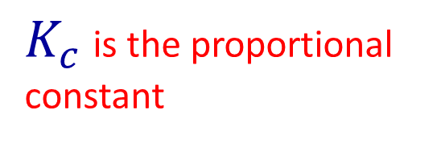

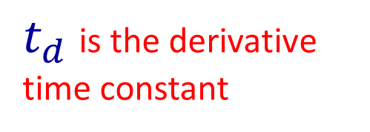
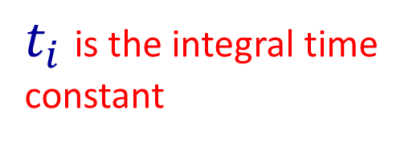
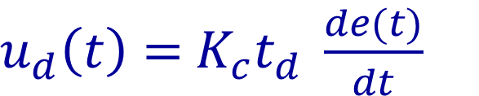
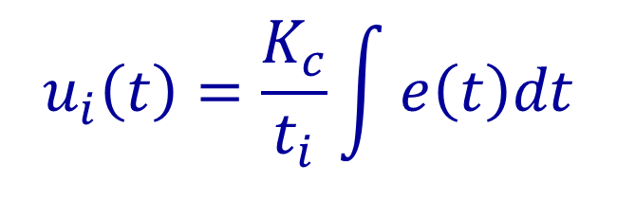
PID
Proportional (proportional to the error)
Integral (proportional to the integral of the error)
Derivative (proportional to the derivative of the error)
$K_{c}$ is the proportional constant
$$u_{p}\left(t\right)=K_{c}e(t)$$
$$u_{i}\left(t\right)=\frac{K_{c}}{t_{i}}\int{e\left(t\right)dt}$$
$t_{i}$ is the integral time constant
$u_{d}\left(t\right)=$ $K_{c}t_{d} \frac{de(t)}{dt}$
$t_{d}$ is the derivative time constant

Slide 4
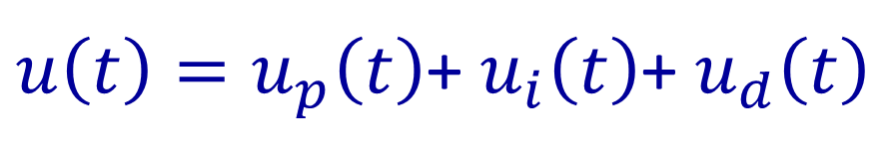
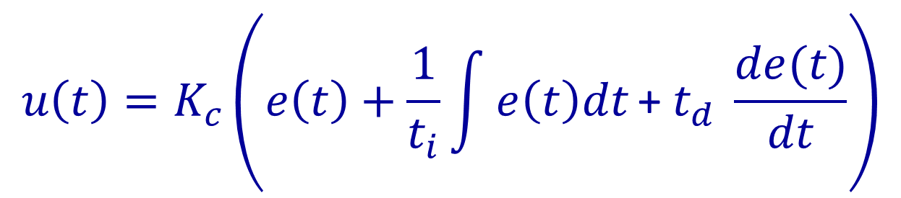
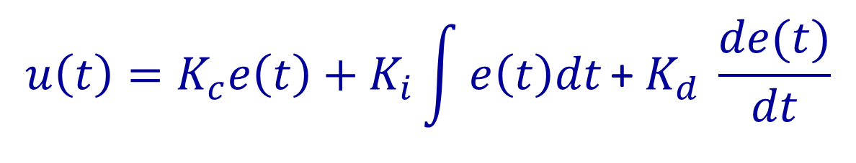
PID – Ideal structure
Proportional, Integrative and Derivative Controller
${u\left(t\right)=u}_{p}\left(t\right)$+ $u_{i}\left(t\right)$+ $u_{d}\left(t\right)$
$${u\left(t\right)=K}_{c}\left(e\left(t\right)+\frac{1}{t_{i}}\int{e\left(t\right)dt}\text{+} t_{d} \frac{de(t)}{dt}\right)$$
$${u\left(t\right)=K}_{c}e\left(t\right)+K_{i}\int{e\left(t\right)dt}\text{+} K_{d} \frac{de(t)}{dt}$$

Slide 5
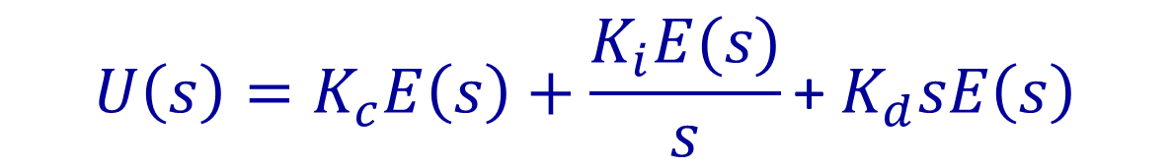
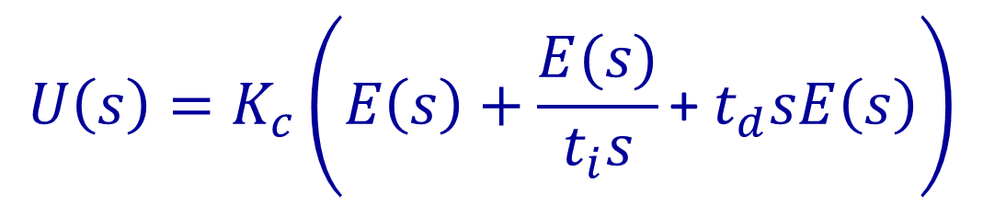

PID – Ideal structure
$${U\left(s\right)=K}_{c}\left(E\left(s\right)+\frac{E(s)}{t_{i}s}\text{+} t_{d}sE\left(s\right)\right)$$
$${U\left(s\right)=K}_{c}E\left(s\right)+\frac{K_{i}E(s)}{s}\text{+} K_{d}sE\left(s\right)$$
$${\frac{U\left(s\right)}{E(s)}=K}_{c}+\frac{K_{i}}{s}\text{+} K_{d}s$$

Slide 6



PID – Ideal structure
$$E\left(s\right)$$
$$K_{c}+\frac{K_{i}}{s}\text{+} K_{d}s$$
$$U\left(s\right)$$

Slide 7
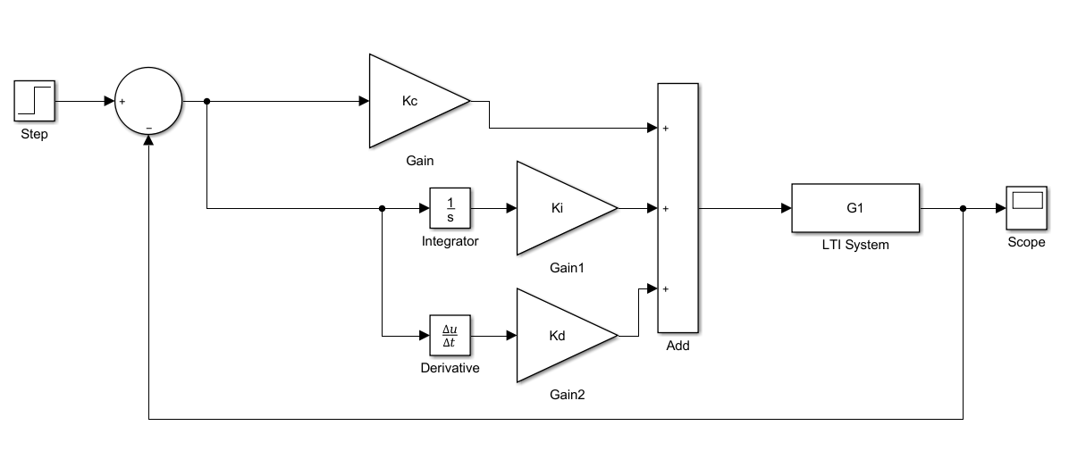
PID
R(S)
E(S)
PID
Controller
U(s)
Y(S)

Slide 8
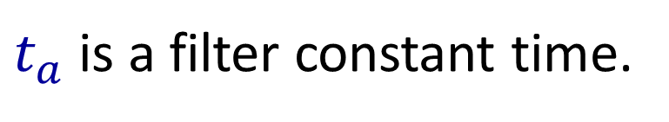
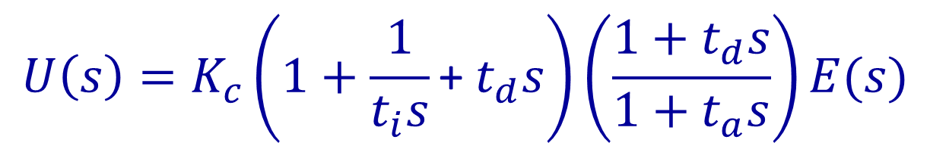
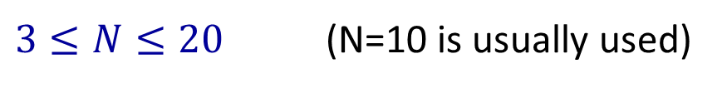

Other PID Structures
Classic structure
$${U\left(s\right)=K}_{c}\left(1+\frac{1}{t_{i}s}\text{+} t_{d}s\right)\left(\frac{1+t_{d}s}{1+t_{a}s}\right)E(s)$$
$t_{a}$ is a filter constant time.
$$t_{a}=\frac{t_{d}}{N}$$
$3≤N≤20$ (N=10 is usually used)

Slide 9
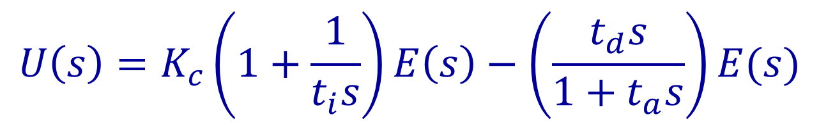
Other PID Structures
Independent parameters structure
$${U\left(s\right)=K}_{c}\left(1+\frac{1}{t_{i}s}\right)E\left(s\right)−\left(\frac{t_{d}s}{1+t_{a}s}\right)E(s)$$

Slide 10
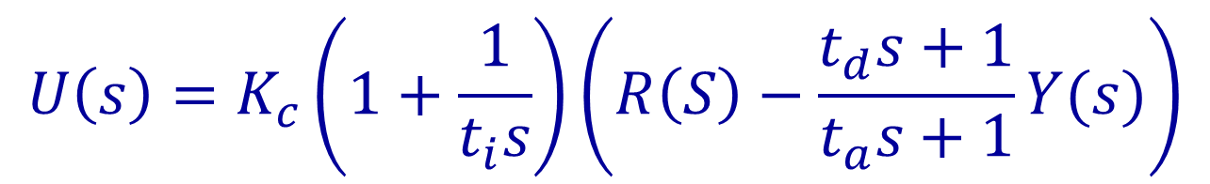
Other PID Structures
Industrial Structure
$${U\left(s\right)=K}_{c}\left(1+\frac{1}{t_{i}s}\right)\left(R\left(S\right)−\frac{t_{d}s+1}{t_{a}s+1}Y(s)\right)$$

Slide 11
Tunning methods

Slide 12
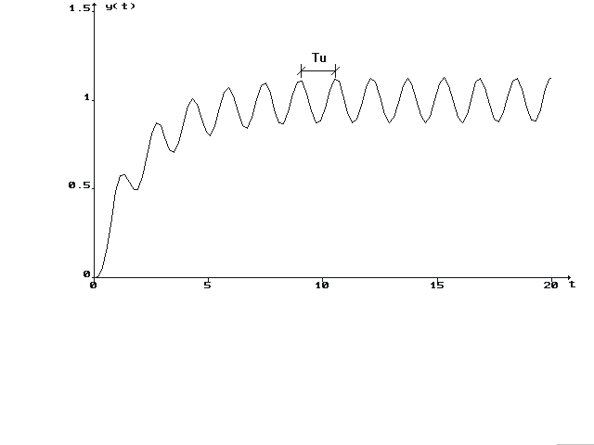


Sustained oscillations Ziegler-Nichols (1942)
Design a proportional controller Ku that provides an output as:
$K_{u}$ is known as the critical gain for the system
$t_{u}$ is the oscillation time

Slide 13
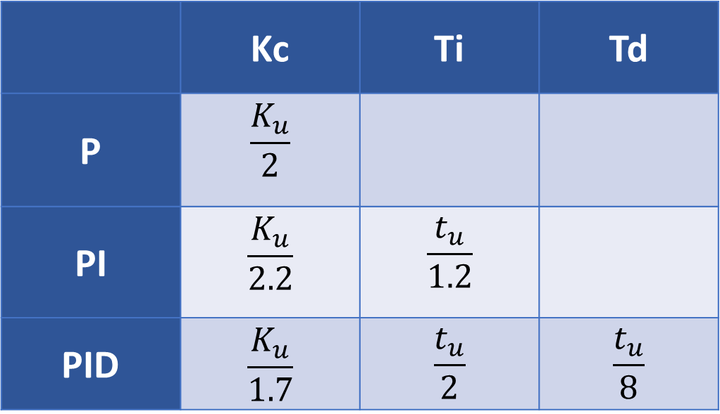
Sustained oscillations Ziegler-Nichols (1942)
Obtain the values for Kc, Ti and Td
 | Kc | Ti | Td
P | $$\frac{K_{u}}{2}$$
PI | $$\frac{K_{u}}{2.2}$$ | $$\frac{t_{u}}{1.2}$$
PID | $$\frac{K_{u}}{1.7}$$ | $$\frac{t_{u}}{2}$$ | $$\frac{t_{u}}{8}$$

Slide 14
Sustained oscillations Ziegler-Nichols (1942)
Some comments:
For the sustained (perpetual) oscillations to exist, the system’s root locus diagram must have a couple of branches crossing the imaginary axis.
For a 2nd order system, the previous can be achieved with a delay.
Use the root locus diagram and find the critical gain in it.

Slide 15
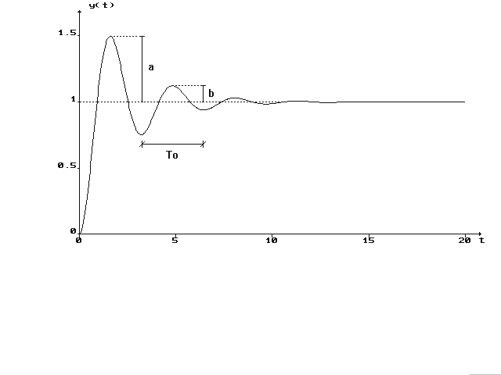
Damped oscillations Harriot (1957)
Design a proportional controller that makes that the first oscillation is four time bigger than the second, with respect to the steady state output.

Slide 16
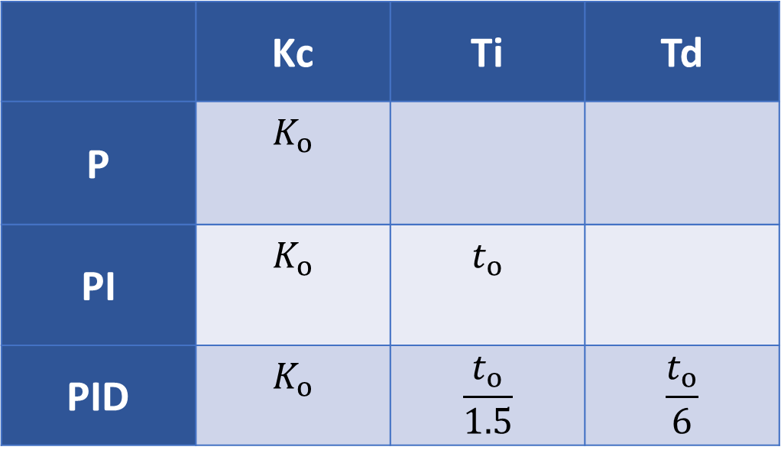
Damped oscillations Harriot (1957)
Obtain the values for Kc, Ti and Td
 | Kc | Ti | Td
P | $$K_{o}$$
PI | $$K_{o}$$ | $$t_{o}$$
PID | $$K_{o}$$ | $$\frac{t_{o}}{1.5}$$ | $$\frac{t_{o}}{6}$$

Slide 17
Damped oscillations Harriot (1957)
Some comments:
For the damped oscillations to occur, the damping ration in closed loop should be 0.21
The previous can be achieved only if the damping ratio of the system in open loop is greater than 0.21

Slide 18






Algebraic Method
$$E\left(s\right)$$
$$U\left(s\right)$$
$$K_{c}+\frac{K_{i}}{s}\text{+} K_{d}s$$
$$E\left(s\right)$$
$$U\left(s\right)$$
$$\frac{{K_{c}s+K}_{i}+K_{d}s^{2}}{s}$$

Slide 19
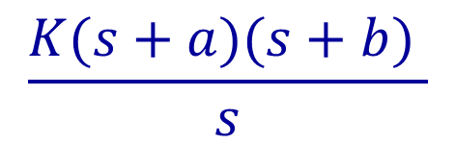

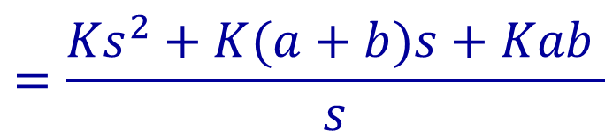
Algebraic Method
$$\frac{{K_{c}s+K}_{i}+K_{d}s^{2}}{s}$$
Two Zeros
One pole in s=0
$$\frac{K(s+a)(s+b) }{s}$$
$$=\frac{{Ks}^{2}+K(a+b)s+Kab }{s}$$
o
o
x
-b
-a

